Slide 1
Simple To Do list using RemixIDE and MetaMask
Vidyavardhini’s College of Engineering & Technology
K.T. Marg, Vartak College Campus, Vasai Rd, Vasai-Virar, Maharashtra 401202
Department of Computer Science and Engineering [Data Science]
Group No: NN
Preet Raut 51
Dipanshu Vartak 62
Shubham Warik 66
Prof. Sumeet Shingi
Date: 4/11/2023

Slide 2
Contents
Introduction
Problem Statement
Literature Survey
Proposed System
Architecture/Framework/Block diagram/Algorithm/Process Design
Details of Hardware/Software used
Output
Result Analysis
Conclusion
References
Thank you

Slide 3
Introduction
Blockchain is a decentralized, distributed ledger technology that ensures secure, transparent, and tamper-proof record-keeping.
In the realm of task management, blockchain technology revolutionizes conventional to-do lists by providing unparalleled security and transparency.
Blockchain ensures tasks are encrypted and immutable, minimizing the risk of data breaches and unauthorized access.
All changes made to the to-do list are visible to every participant in the network, fostering trust and accountability.
Eliminates the need for a central authority, empowering users to have complete control over their tasks without intermediaries.

Slide 4
Problem Statement
Conventional to-do list apps often suffer from security vulnerabilities, making user data susceptible to hacks and unauthorized access.
Centralized task management systems are controlled by a single entity, limiting user autonomy and leading to potential data manipulation.
Tasks and their statuses can be altered without detection, compromising the integrity of task-related information.
With the rise in cyber threats, securing user data in task management applications is crucial to prevent breaches and protect sensitive information.

Slide 5
Literature Survey
Sr. No | Paper Title | Advantages | Disadvantages
1 | Blockchain-Based To-Do Lists for Project Management: A Comparative Analysis of Security and Efficiency | Focusing on the benefits of task transparency, automated progress tracking. | This research may require access to real-world project management data
2 | Decentralized Task Verification on Blockchain: Ensuring Authenticity and Accountability in To-Do Lists | Explore the implications for trust and responsibility in task management. | This research would need to address privacy concerns related to task verification
3 | Blockchain-Powered To-Do Lists in Education: A Case Study on Student Task Management | Explore the impact on student productivity and goal attainment. | Gathering data from educational institutions and ensuring privacy.
4 | The Environmental Impact of Blockchain-Based To-Do Lists: A Sustainability Assessment | Investigate the environmental impact of blockchain technology. | This research would require access to energy consumption data of blockchain networks and may involve complex calculations.
5 | User Experience and Adoption of Blockchain To-Do Lists: A Human-Centered Approach | Informs about usability, user satisfaction, and barriers to adoption, with a focus on user-centered design principles. | Informs about usability, user satisfaction, and barriers to adoption, with a focus on user-centered design principles.

Slide 6
Proposed system
Decentralization: Our proposed system leverages blockchain technology to decentralize task management, eliminating the need for a central authority and promoting user empowerment.
Immutability: Tasks and their statuses are recorded in an immutable ledger, ensuring that once a task is added, it cannot be altered or deleted without consensus from the network.
Transparency: All participants in the network have real-time visibility into the to-do list. Changes and updates are visible to everyone, enhancing transparency and accountability.
User Authentication: Users are securely authenticated, ensuring that only authorized individuals can access and manage the to-do list.
.

Slide 7
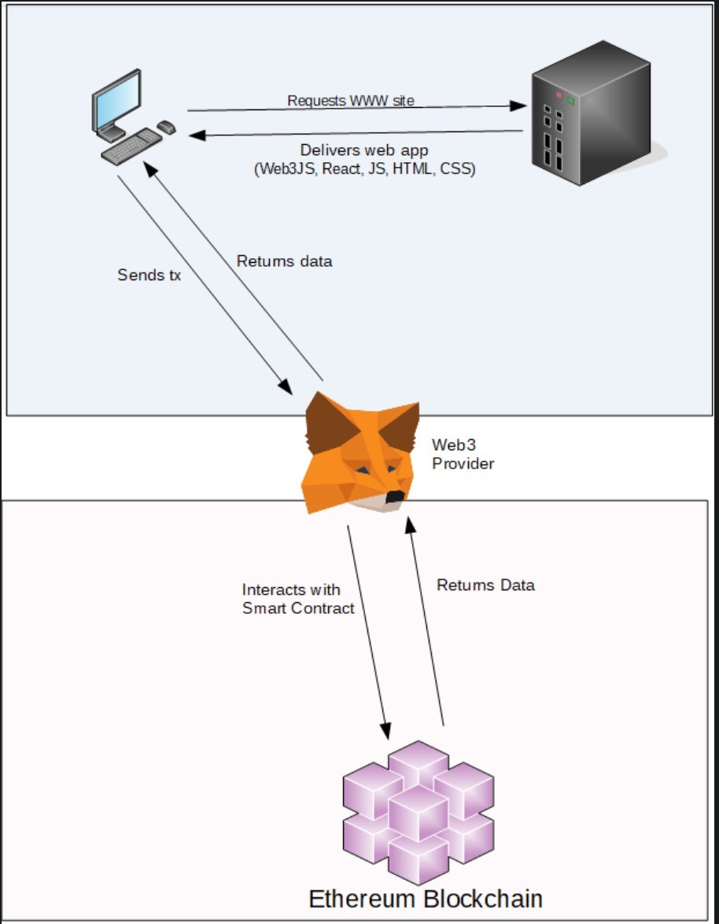
Framework
Fig Transaction process on Metamask

Slide 8
Details of Hardware/Software used
Hardware Requirements:
Processor: Intel(R) Core(TM) i5-10300H CPU @ 2.50GHz 2.50 GHz
Memory (RAM): 8.00 GB DDR4
Storage: 512 GB SSD
Software Requirements:
Ganache: Providing local blockchain network
MetaMask extension: Performing ethereum transactions
MetaMask extension: Performing ethereum transactions

Slide 9
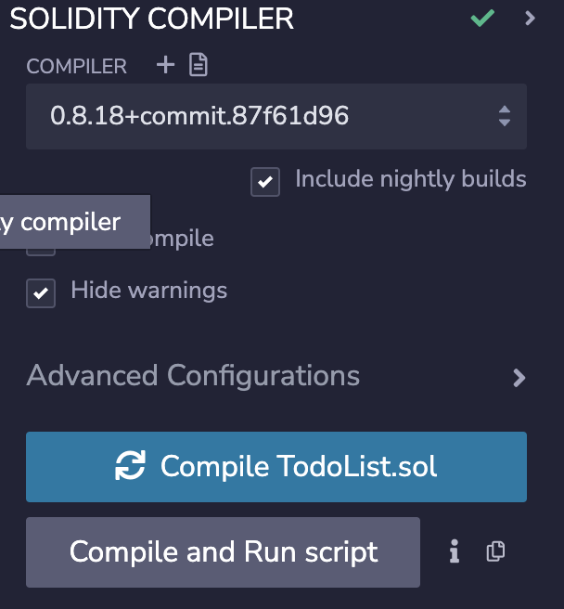
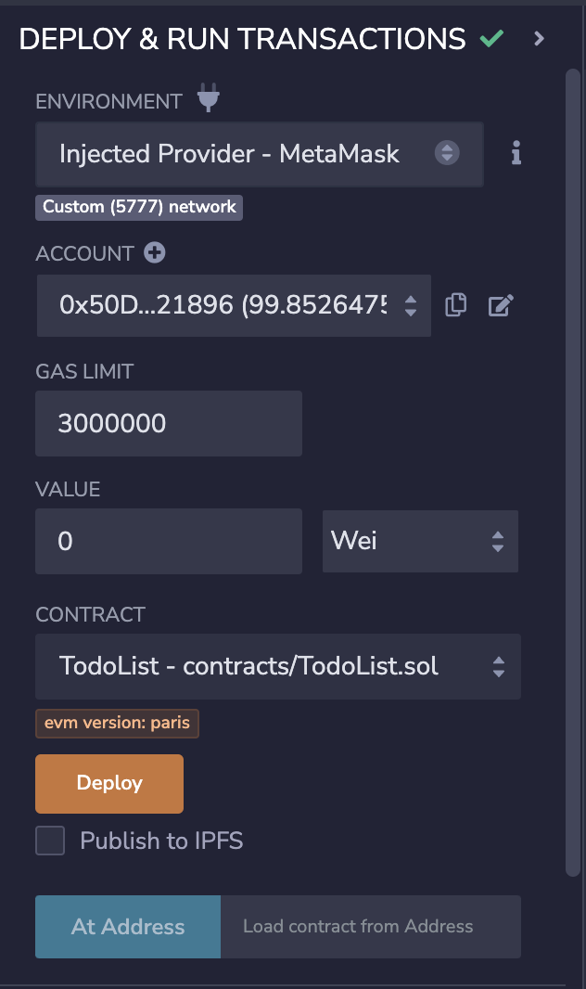
Output
Fig Solidity Compiler in RemixIDE Fig Smart contract deployment

Slide 10

Fig Interface to add, remove and complete task

Slide 11
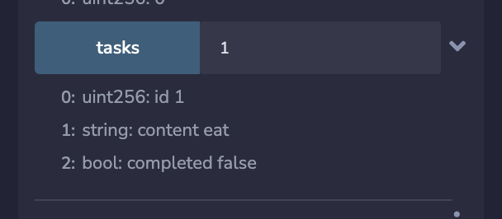
Fig Task details

Slide 12
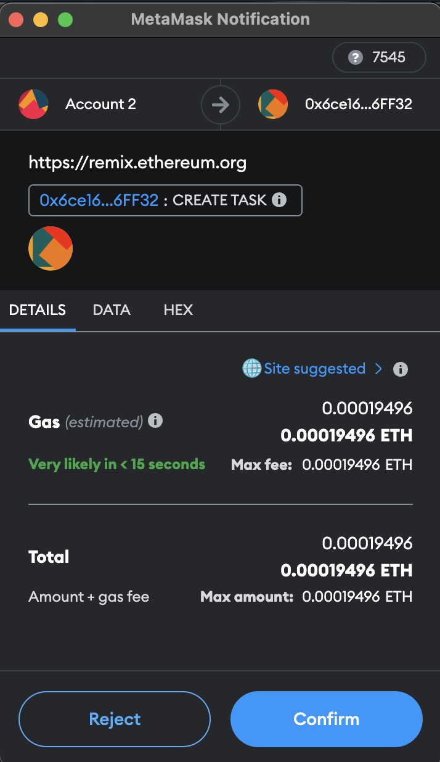
Fig Action confirmation in Metamask

Slide 13
Result Analysis
A blockchain-based ToDo-List application offers both advantages and challenges in its result analysis. On the positive side, the transparency and immutability inherent to blockchain technology ensure the security and integrity of the data stored in the system, making it resistant to unauthorized changes and tampering.Furthermore, the decentralized and distributed nature of the blockchain network enable manipulating tasks impossible without users permission.
The decentralization aspect, particularly when coupled with tools like Ganache and MetaMask, establishes a resilient system that is resistant to downtime or data loss, ensuring continuous access to task information.

Slide 14
Conclusion
Integration of blockchain into to-do list applications represents a significant step forward in the realm of task management. By leveraging the security, transparency, and trust inherent to blockchain, we have the opportunity to redefine how individuals and organizations organize their daily activities. This innovation enhances the security and integrity of task data, promotes accountability and trust through transparent ledgers, and ensures uninterrupted access to to-do lists.

Slide 15
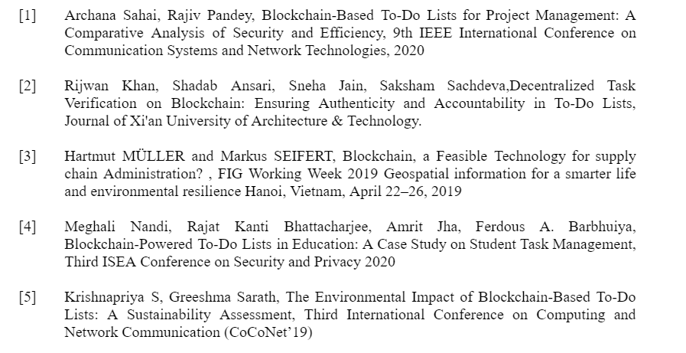
References

Slide 16
Thank you

